Slide 1
Predicting Restaurant Success and Rating with Yelp
Presented By –
Foram Mehta
Meenakshi Paryani
CMPE 255 Final Project under guidance of Prof. David Anastasiu Noopur Joshi

Slide 2
Motivation and Goal of our Project..
Goal
Predict Restaurant Success with Binary Classification
Predict Restaurant Rating with Multi Class Classification
Predict Restaurant Rating with Regression
Provide top 5 most important features that determine the restaurant’s success
Provide top 5 most negative features that determine the restaurant’s failure
Motivation
According to a frequently cited study by Ohio State University on failed restaurants,
60 % do not make it past the first year
80 % go under in 5 years

Slide 3
Data Pre-Processing
Using Label Encoding
Converting Categorical attributes into numerical
Ex – Ambience – Classy, Casual, Dressy etc
Using Pandas (Get Dummies)
Mapping each categorical value to an attribute column and assigning it a value of 0/1 based on absence/presence of an attribute
Test and Train Split
Used K Fold Cross Validation Technique (80/20 ratio for train/test)
Pre-Processing for Binary Classification
Pre-Processing for Multi-Class Classification
Removing Outliers

Slide 4
Dimensionality Reduction
Dimensions after Pre-Processing – 88
DR Algorithms applied – Chi Square and TruncatedSVD
Dimensions after reduction – 50 - 100
Removed Irrelevant columns which have no contribution to success prediction to improve the accuracy of the model
Ex – Address, Zip Code, BYOB
Accuracy Improved after removing irrelevant columns
Re-Processed the data again after column removal
Applied SelectKBest technique with Chi-Square Test for feature selection
Selected top 30 features from each class

Slide 5
Validation For Multi-Class classification and Regression
Classifier | Train Accuracy | Test Accuracy
SVM | 0.756 | 0.7493
Random Forest | 0.7593 | 0.75
Multi-Layer Neural Network | 0.773 | 0.75
Regression Technique | SSE | Variance
Label Encoding | 0.32 | 0.09
Binarization | 0.3 | 0.14

Slide 6
Accuracy For Binary Classification
Classifier | Train Accuracy | Test Accuracy
Decision Tree | 0.9899 | 0.7685
Random Forest | 0.8599 | 0.7796
Multi-Layer Neural Network | 0.8411 | 0.8016
Gaussian NB | 0.6958 | 0.513
AdaBoost | 0.834 | 0.8053

Slide 7
Positive Vs Negative Best Feature
Positive Best Features | Negative Features
WiFi | Karaoke Features
Business Parking | Validated Business Parking
Ambience | Best Nights
Price Range | Video Music
Attire
Type of Meal

Slide 8
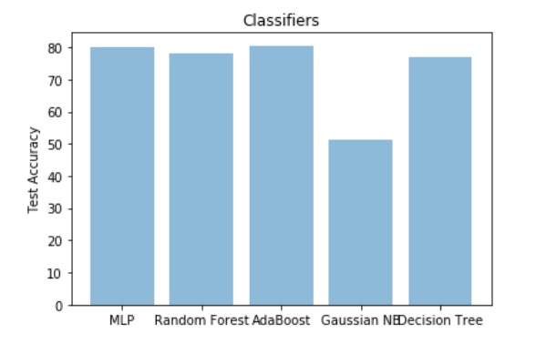
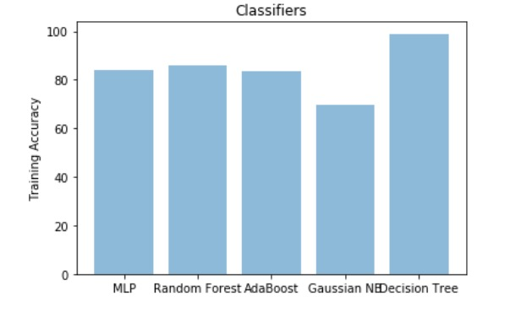
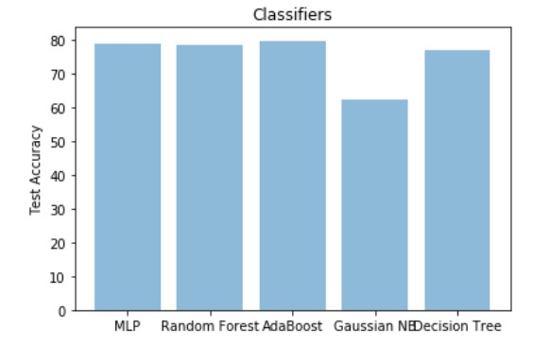
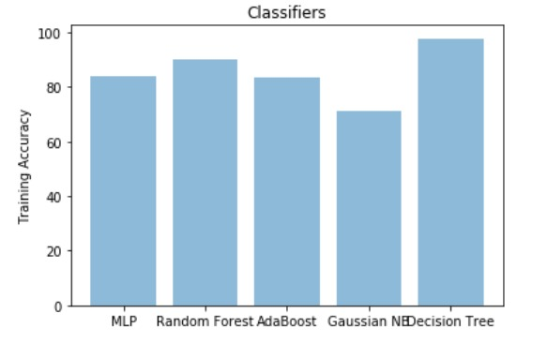
Results - Binary Classification

Slide 9
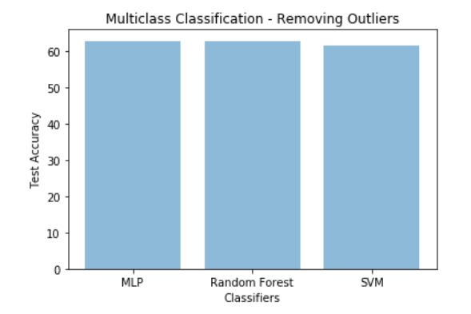
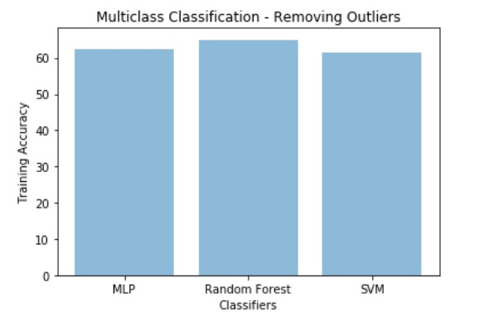
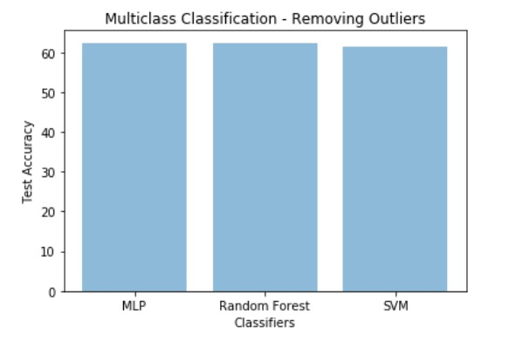
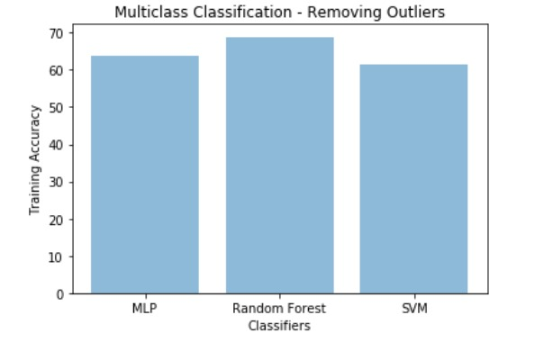
Results – Multi Class Classification

